Slide 1

Strings and Pattern Matching
Brute Force,Rabin-Karp, Knuth-Morris-Pratt
Regular Expressions

Slide 2
String Searching
The object of string searching is to find the location of a specific text pattern within a larger body of text (e.g., a sentence, a paragraph, a book, etc.).
As with most algorithms, the main considerations for string searching are speed and efficiency.
There are a number of string searching algorithms in existence today, but the three we shall review are Brute Force,Rabin-Karp, and Knuth-Morris-Pratt.

Slide 3
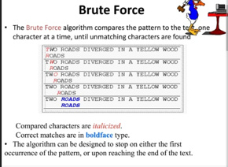

Slide 4
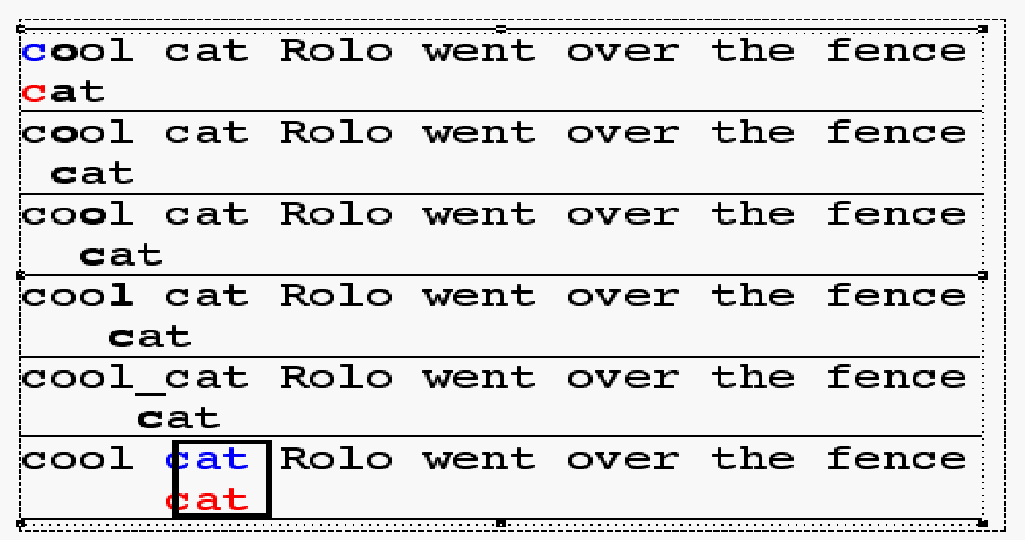
Brute Force Pseudo-Code
Here’s the pseudo-code
do if (text letter == pattern letter)
compare next letter of pattern to next
letter of text
else move pattern down text by one letter
while (entire pattern found or end of text)

Slide 5
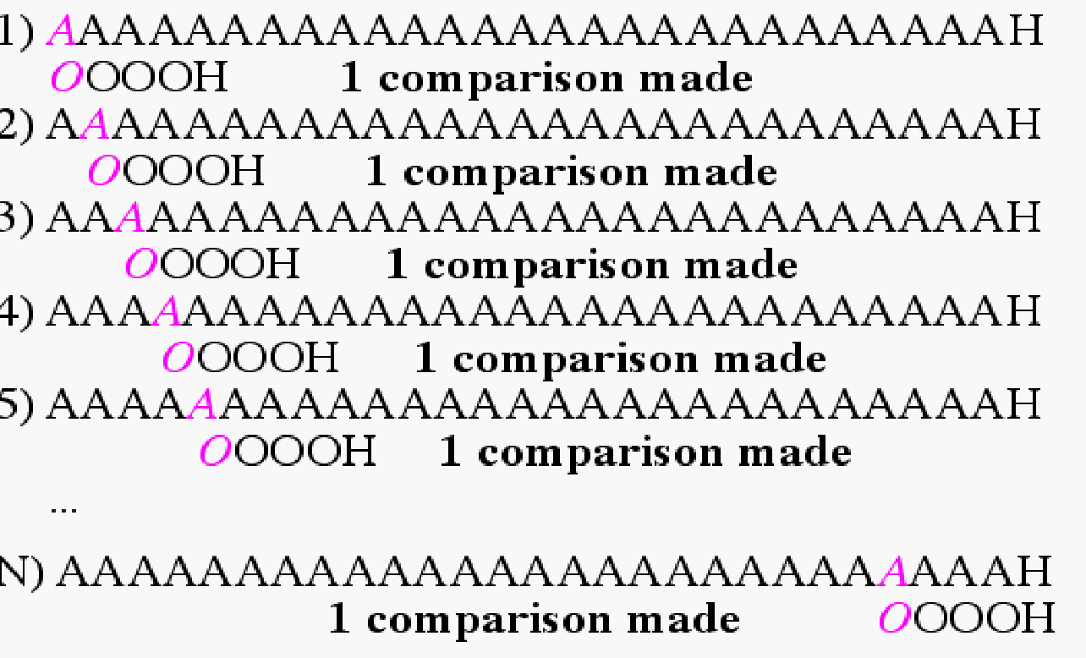
Brute Force-Complexity
Given a pattern M characters in length, and a text N characters in length...
Best case if pattern not found: Always mismatch on first character. For example, M=5.
Total number of comparisons: N
Best case time complexity: O(N)

Slide 6
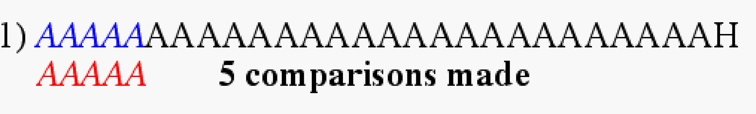
Brute Force-Complexity
Given a pattern M characters in length, and a text N characters in length...
Best case if pattern found: Finds pattern in first M positions of text. For example, M=5.
Total number of comparisons: M
Best case time complexity: O(M)

Slide 7
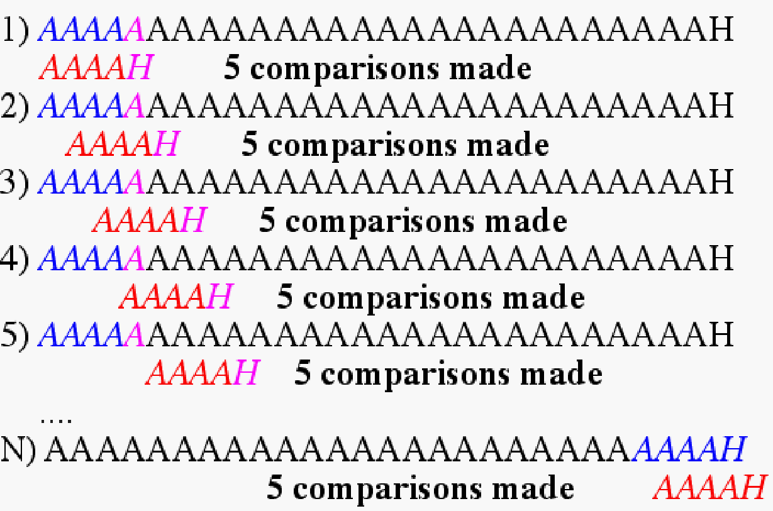
Brute Force-Complexity
Given a pattern M characters in length, and a text N characters in length...
Worst case: compares pattern to each substring of text of length M. For example, M=5.
This kind of case can occur for image data.
Total number of comparisons: M (N-M+1)
Worst case time complexity: O(MN)

Slide 8
Rabin-Karp
The Rabin-Karp string searching algorithm calculates a hash value for the pattern, and for each M-character subsequence of text to be compared.
If the hash values are unequal, the algorithm will calculate the hash value for next M-character sequence.
If the hash values are equal, the algorithm will do a Brute Force comparison between the pattern and the M-character sequence.
In this way, there is only one comparison per text subsequence, and Brute Force is only needed when hash values match.
Perhaps an example will clarify some things...

Slide 9
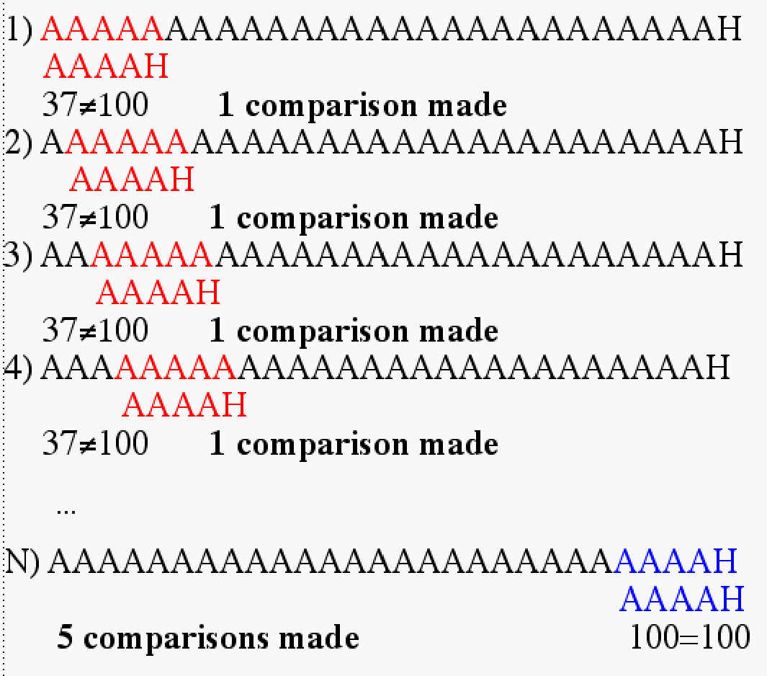
Rabin-Karp Example
Hash value of “AAAAA” is 37
Hash value of “AAAAH” is 100

Slide 10
Rabin-Karp Algorithm
pattern is M characters long
hash_p=hash value of pattern
hash_t=hash value of first M letters in body of text
do
if (hash_p == hash_t)
brute force comparison of pattern
and selected section of text
hash_t= hash value of next section of text, one character over
while (end of text or
brute force comparison == true)

Slide 11
Rabin-Karp
Common Rabin-Karp questions:
“What is the hash function used to calculate values for character sequences?”
“Isn’t it time consuming to hash very one of the M-character sequences in the text body?”
To answer some of these questions, we’ll have to get mathematical.

Slide 12
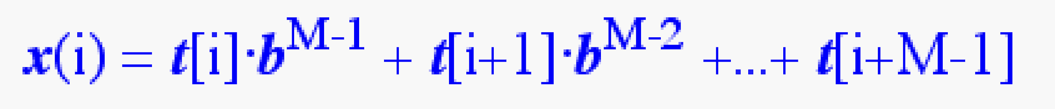
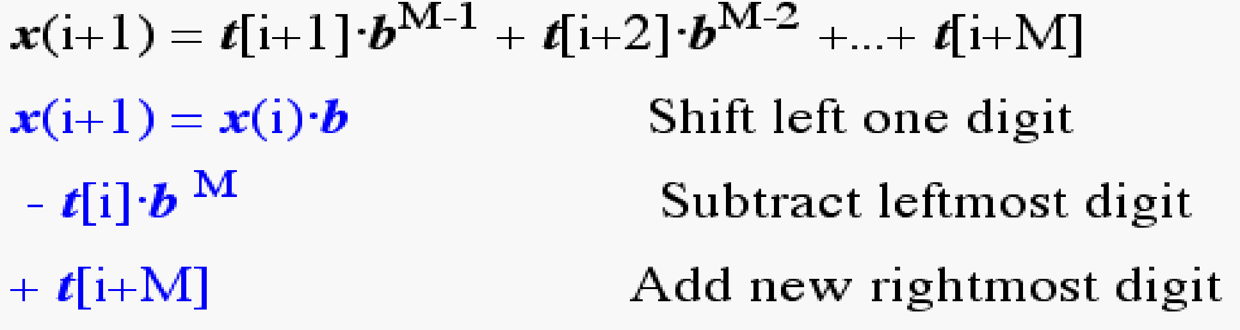
Rabin-Karp Math
Consider an M-character sequence as an M-digit number in base b, where b is the number of letters in the alphabet. The text subsequence t[i .. i+M-1] is mapped to the number
Furthermore, given x(i) we can compute x(i+1) for the next subsequence t[i+1 .. i+M] in constant time, as follows:
In this way, we never explicitly compute a new value. We
simply adjust the existing value as we move over one
character.

Slide 13
Rabin-Karp Math Example
Let’s say that our alphabet consists of 10 letters.
our alphabet = a, b, c, d, e, f, g, h, i, j
Let’s say that “a” corresponds to 1, “b” corresponds to 2 and so on.
The hash value for string “cah” would be ...
3*100 + 1*10 + 8*1 = 318

Slide 14
Rabin-Karp Mods
If M is large, then the resulting value (~bM) will be enormous. For this reason, we hash the value by taking it mod a prime number q.
The mod function (% in C) is particularly useful in this case due to several of its inherent properties:
[(x mod q) + (y mod q)] mod q = (x+y) mod q
(x mod q) mod q = x mod q
For these reasons:
h(i)=((t[i]⋅ b^{M-1} mod q) +(t[i+1]⋅ b^{M-2} mod q) + ...
+(t[i+M-1] mod q))mod q
h(i+1) =( h(i) ⋅ b mod q
Shift left one digit
-t[i] ⋅ b^{M} mod q
Subtract leftmost digit
+t[i+M] mod q )
Add new rightmost digit
mod q

Slide 15
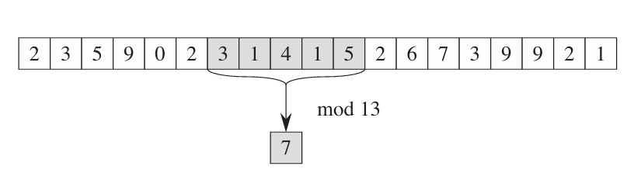
Example
If the string is: 2359023141526739921
Pattern: 31415
Pattern size is 5, base 10 and mod 13
Hash(31415) = (3*10^4 + 1*10^3 + 4*10^2 + 1*10^1 + 5*10^0 ) mod 13 = 7

Slide 16
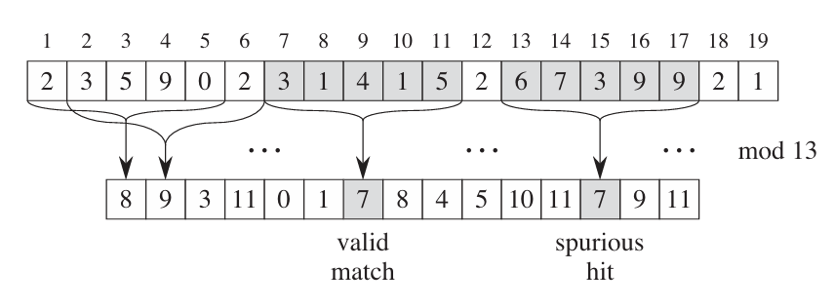
Example
If the string is: 2359023141526739921
Pattern size is 5, base 10 and mod 13

Slide 17
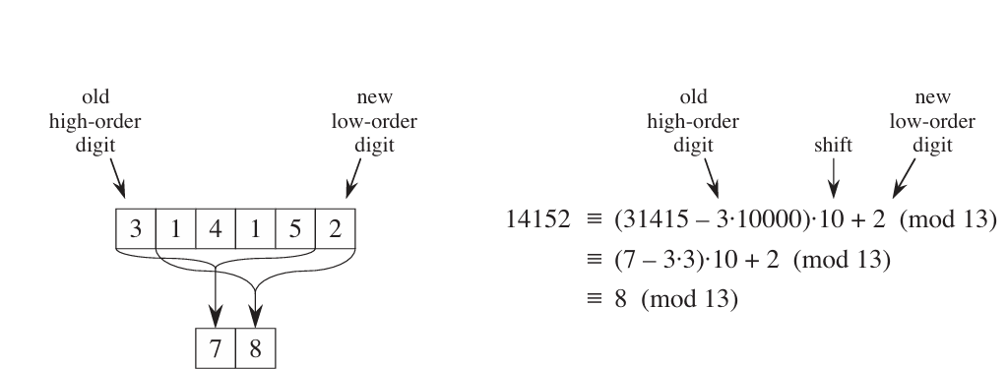
Example
If the string is: 2359023141526739921
Pattern size is 5, base 10 and mod 13
Notes:
(7−3⋅3).10+2=(7−9) .10+2=(−2) .10+2=−18.
Now, find the remainder when dividing by 13 (the modulus): −18(mod13)−18(mod13).
To make the result positive, we add a multiple of 13 that brings us closer to zero: −18+13=−5−18+13=−5.
Finally, take the remainder: −5(mod13)=8−5(mod13)=8.
So, (7−3⋅3)⋅10+2≡8(mod13)(7−3⋅3)⋅10+2≡8(mod13)

Slide 18
Rabin-Karp Complexity
If a sufficiently large prime number is used for the hash function, the hashed values of two different patterns will usually be distinct.
If this is the case, searching takes O(N) time, where N is the number of characters in the larger body of text.
It is always possible to construct a scenario with a worst-case complexity of O(MN). This, however, is likely to happen only if the prime number used for hashing is small.

